Slide 1



PRESENTS
An initiative generously supported by the

Slide 2

Facts
According to a study conducted by the National Academy of Medicine (NAM)
  $210 billion of the $750 billion of excess spending in the USA is spent on unnecessary or needlessly expensive care
  30,000 deaths per year can be attributed to this low value care
  Low value care is contributing to higher health care premiums

Slide 3
History of Choosing Wisely
Survey conducted by the American Board of Internal Medicine Foundation (ABIMF) found:
  Physicians felt pressured by patients to prescribe unnecessary tests or treatments and feared lawsuits or losing patients if said “no”
  Physicians lacked the tools to have conversations with patients
  Patients felt uncomfortable asking their doctor questions
ABIMF Launched Choosing Wisely in 2012

Slide 4

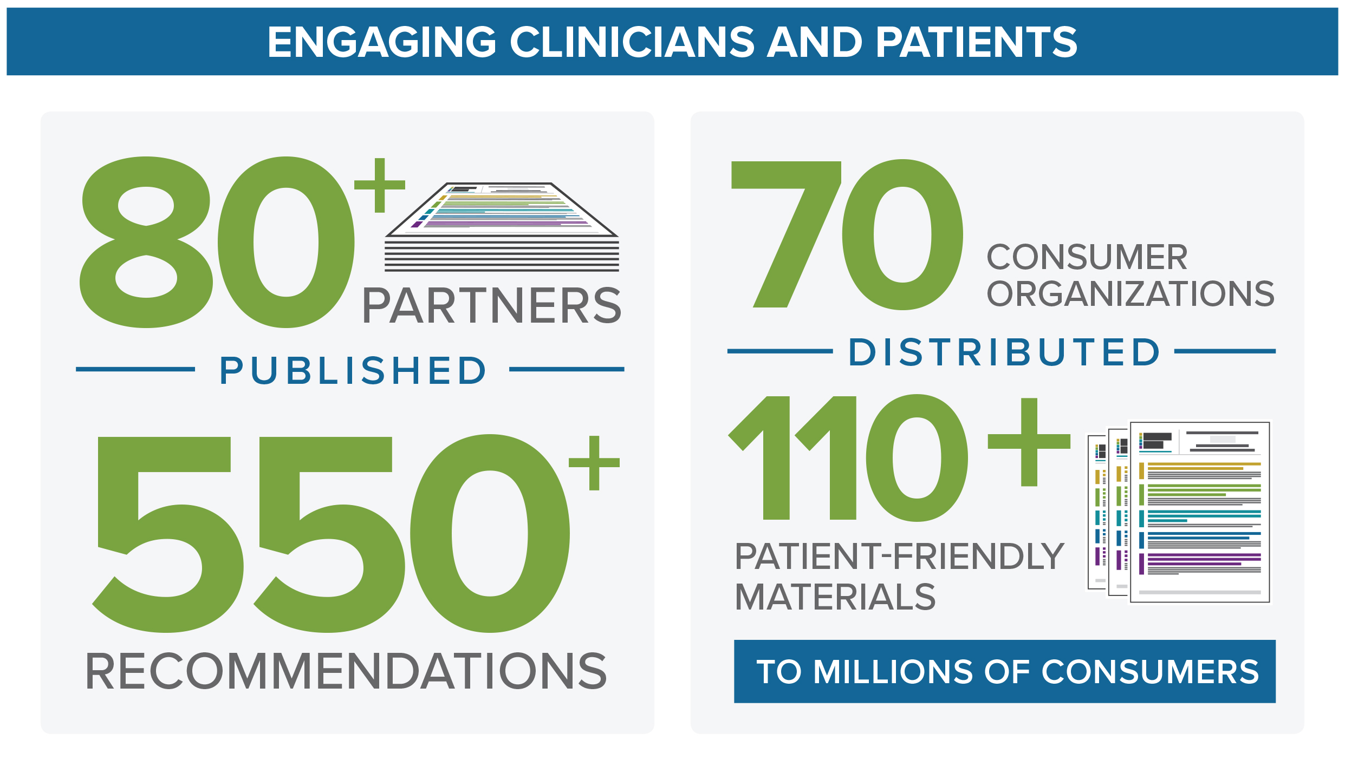
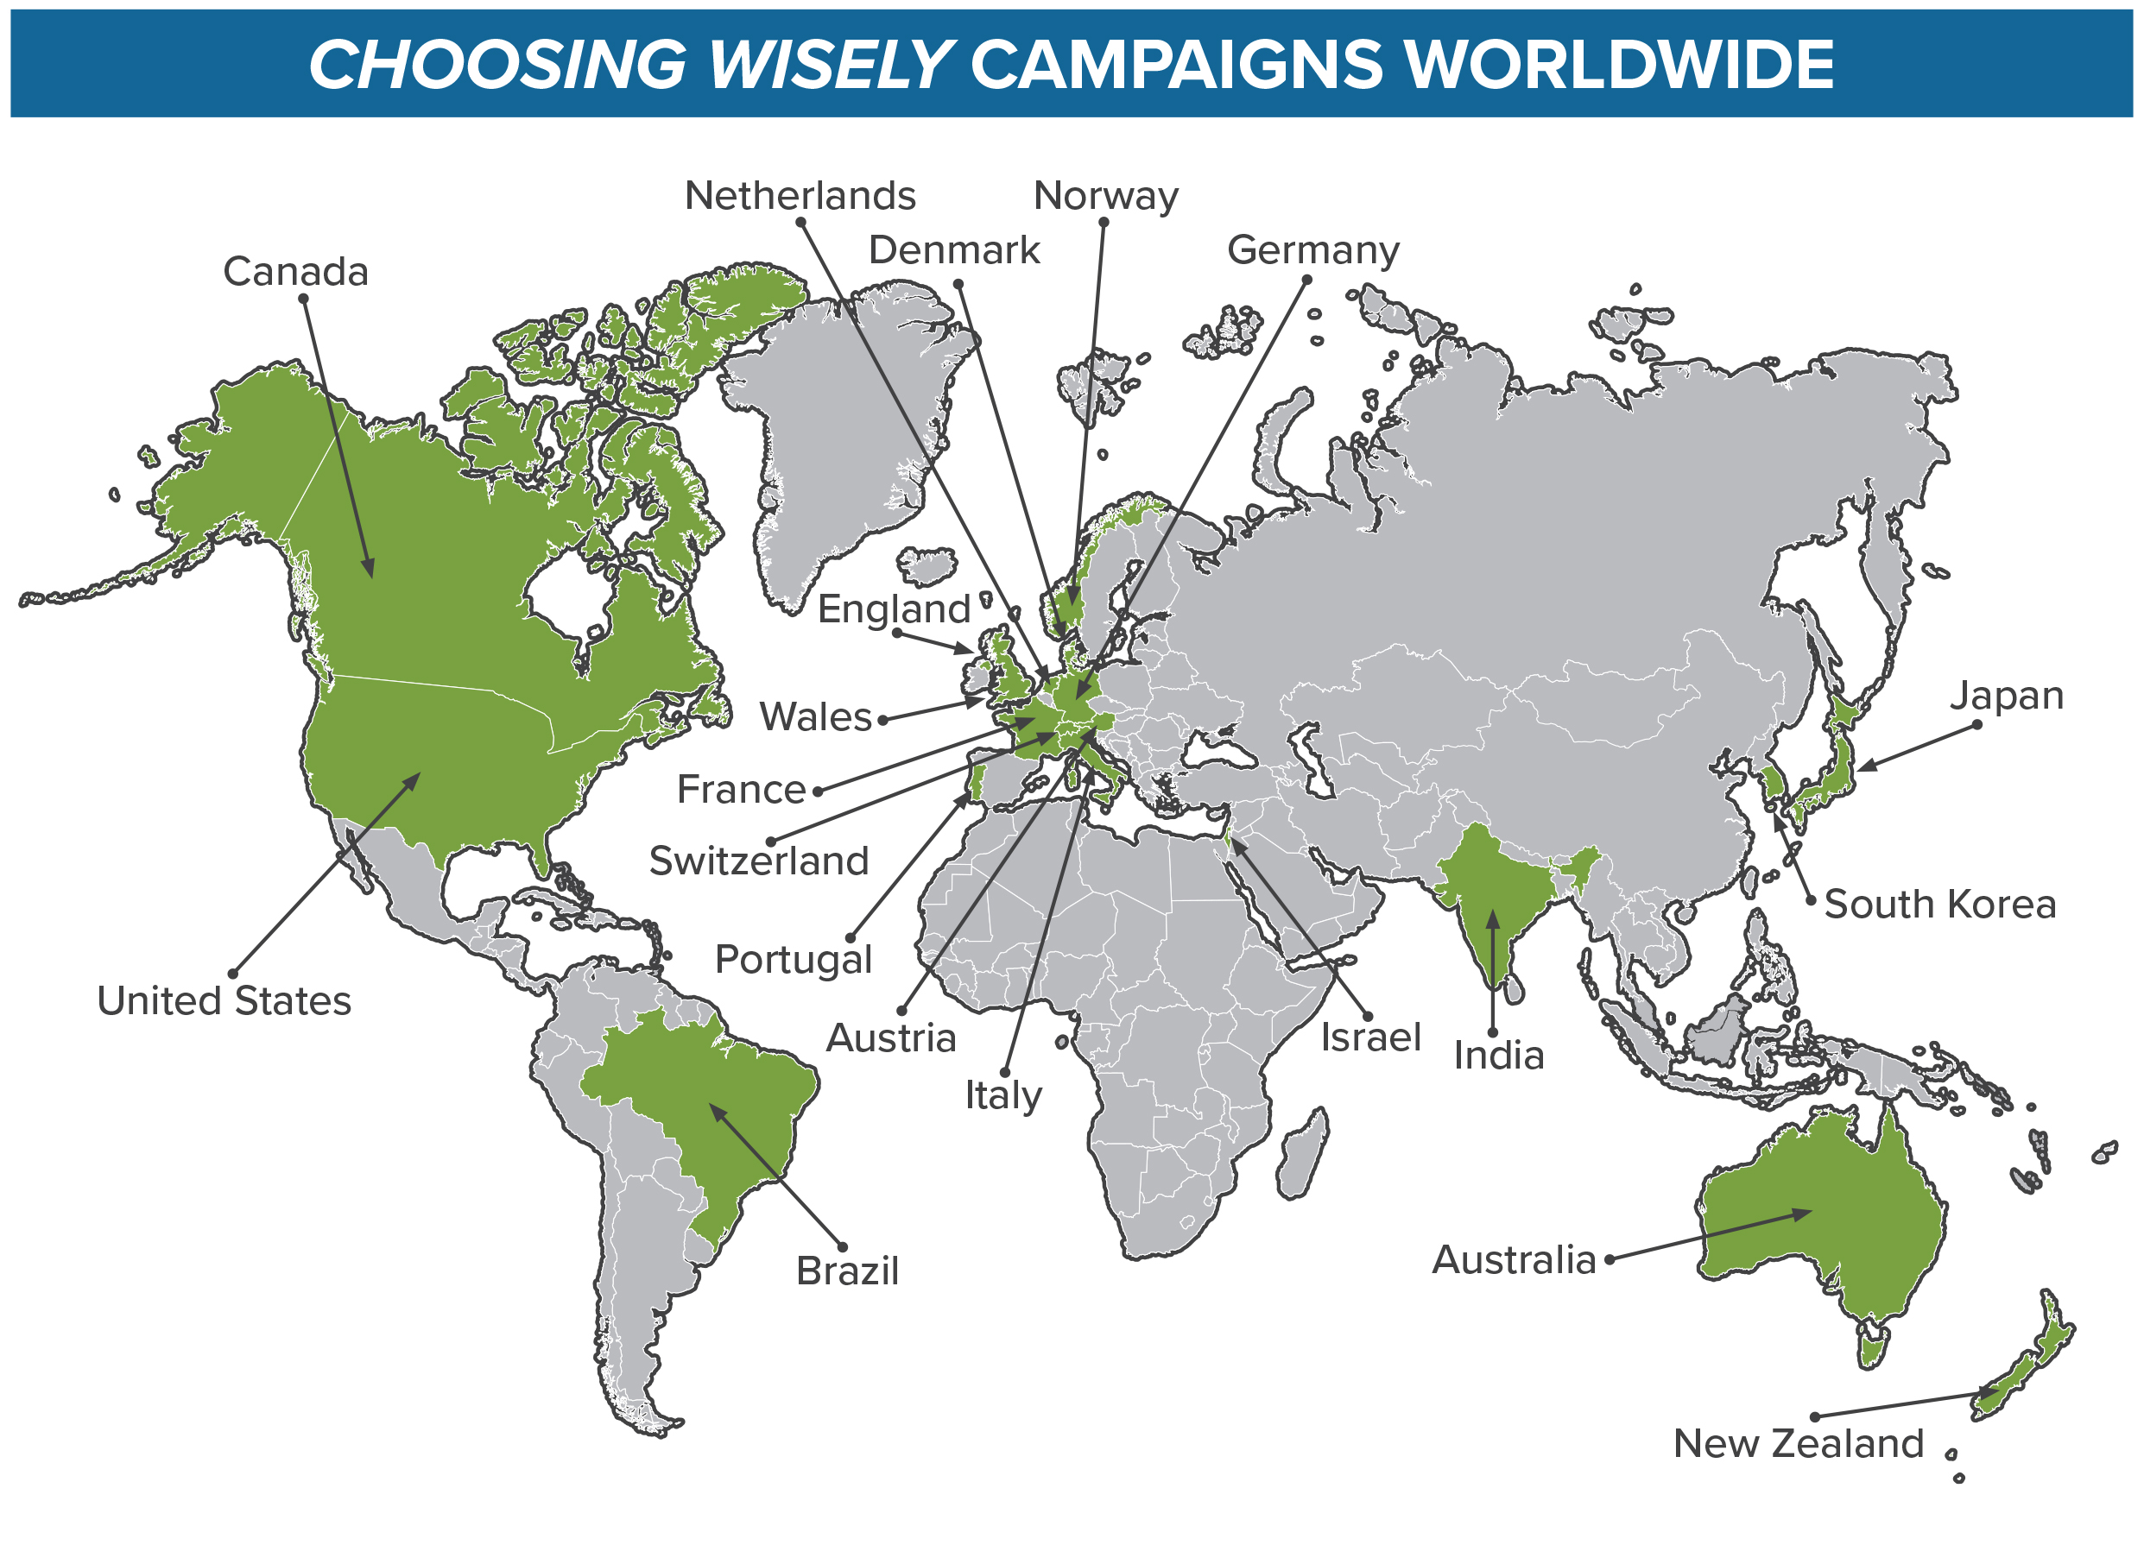
Choosing Wisely Campaign
Initiative of the American Board of Internal Medicine Foundation (ABIMF)
Goal: drive appropriate prevention and reduce unnecessary tests and procedures
Strategy: promote conversations between doctors and patients about their treatment options, risks, and cost
Evidence-based materials and recommendations developed by 80+ Medical Specialty Boards
Active Campaigns in 20 Countries

Slide 5
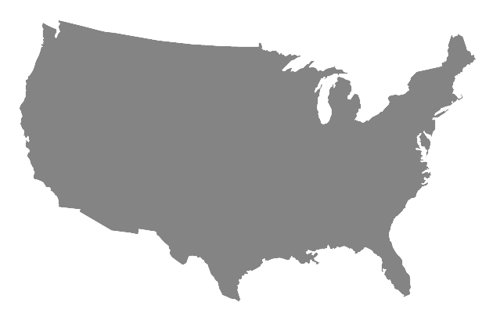


Choosing Wisely-RI
RI 1st CW State
Statewide campaign launched by the RI Business Group on Health (RIBGH)
  Targeting RI employers of all sizes and industries, healthcare providers, and consumers of healthcare services
Similar approach as Seat Belt and Anti-smoking Campaigns
Governor Raimondo declared RI a Choosing Wisely State
Supported by the RI Department of Health, RI Medical Society, RI Foundation & Health Plans

Slide 6
5 Questions to Ask Your Doctor
Do I really need this test or procedure?
What are the risks and side effects?
Are there simpler safer options?
What happens if I don’t do anything?
How much does it cost and will my insurance pay for it?

Slide 7



























The Choosing Wisely-RI Campaign
is Growing!
Warwick Senior Center
DESIGN FABRICATORS
Scituate Senior Center
University Medicine
SMITHFIELD SENIOR CENTER
Tiverton Senior Center
EAST PROVIDENCE SENIOR CENTER
Kahn Litwin Renza
Benjamin Church Senior Center
Coventry Senior Center
Town Of Cumberland Senior Center

Slide 8
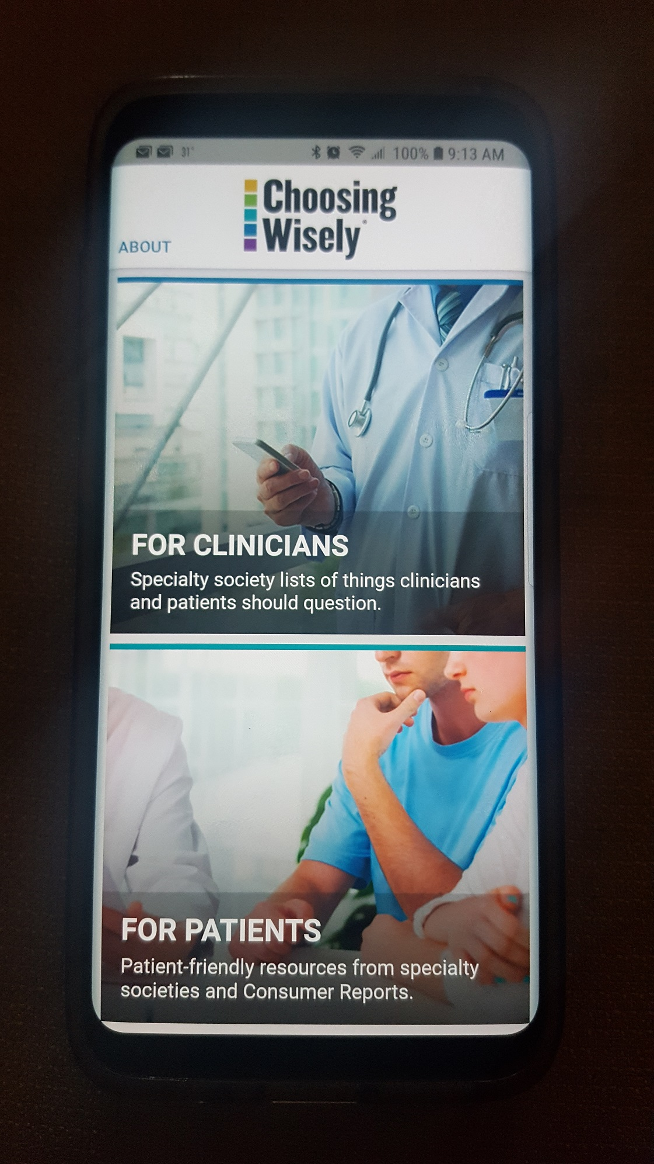
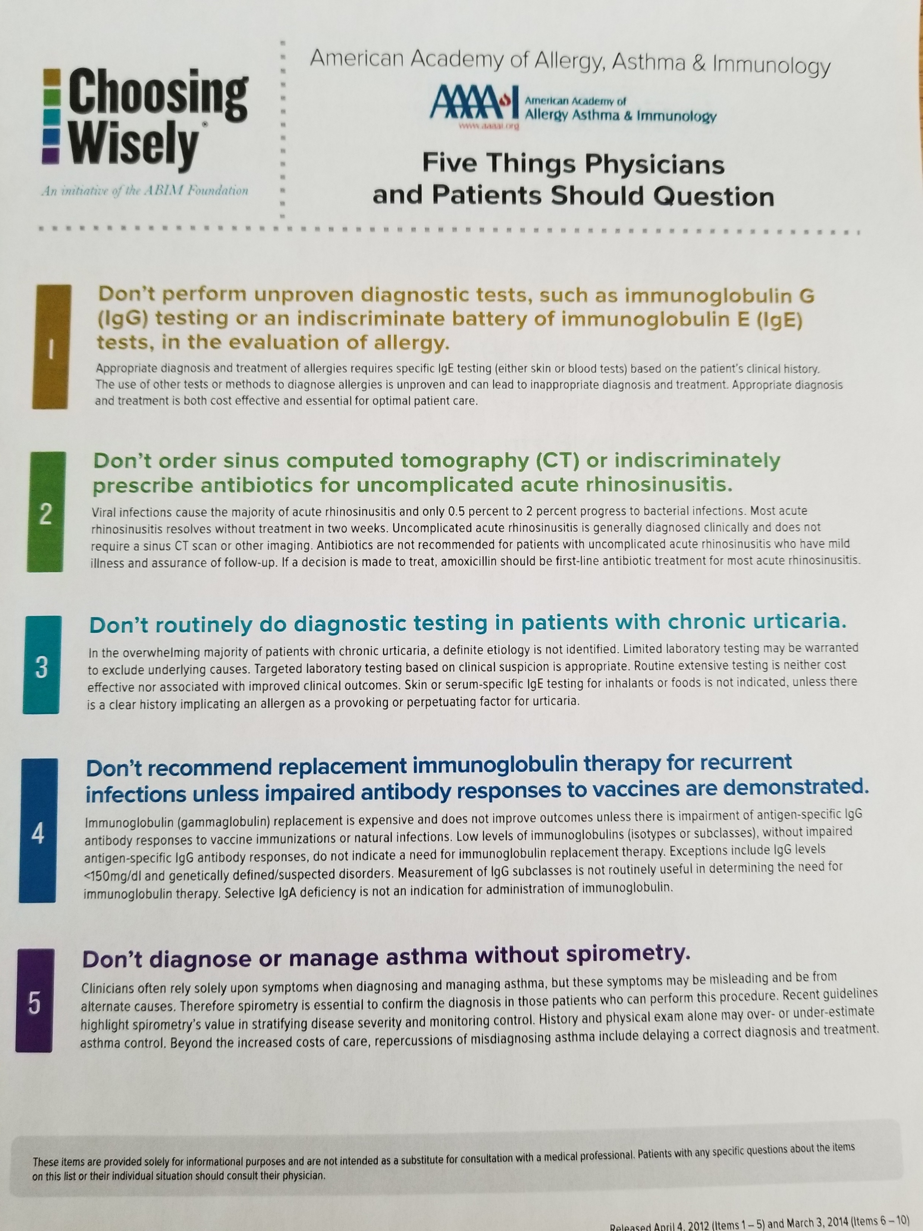
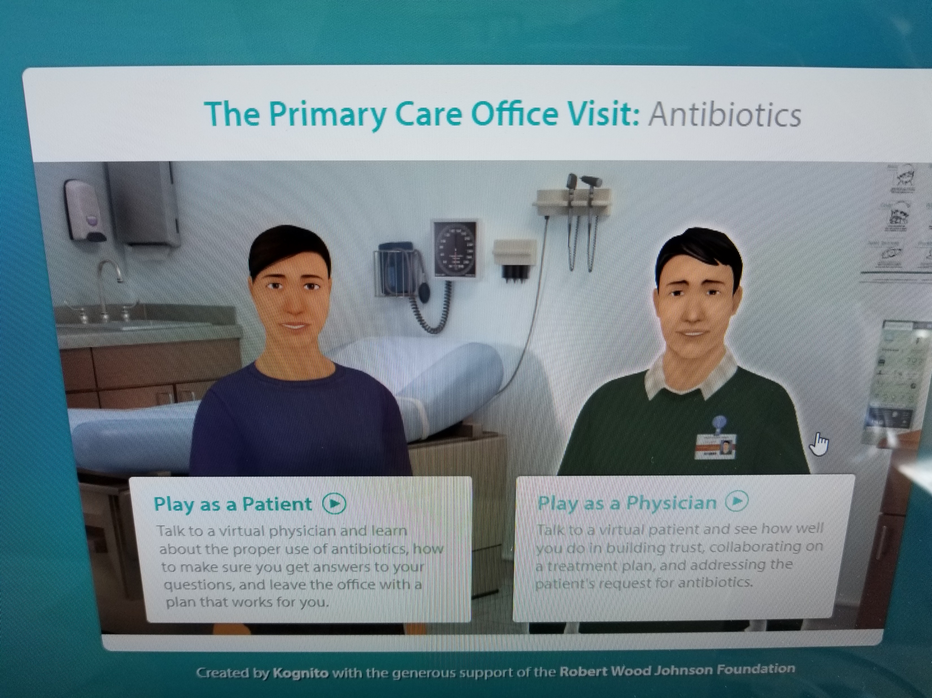
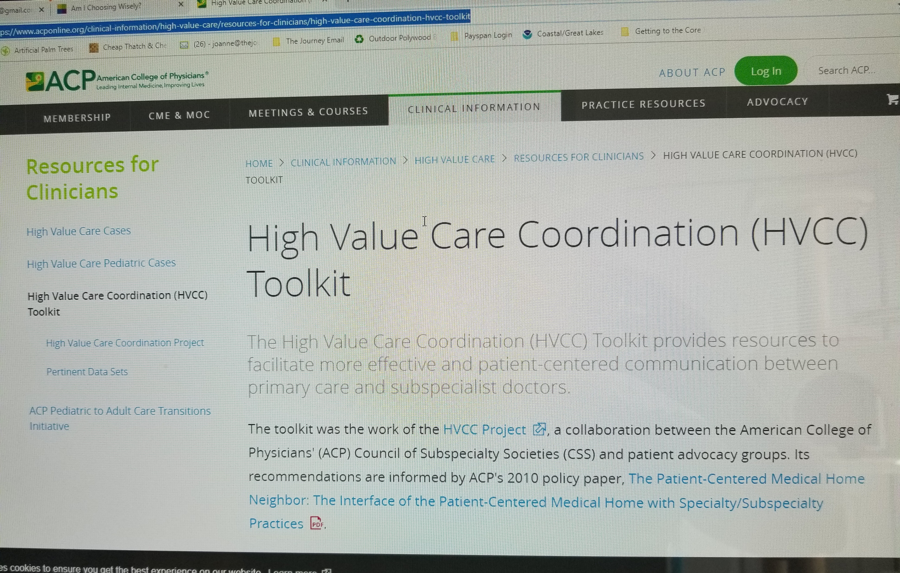


Physician Materials & Tools
Provided Free of Charge:
  Over 550 Recommendations
  Simulated Encounter Tools & Videos
  Educational Training Modules & Toolkits
    Some Are CME Eligible
  Choosing Wisely Webinars
  Shared Data From Choosing Wisely Campaigns Around the World
  Choosing Wisely Cell Phone App
    Free and available on Google Play & iTunes

Slide 9
Location of Physician/Clinician Tools
Physician Toolkit
  http://www.choosingwisely.org/wp-content/uploads/2017/01/Using-Choosing-Wisely-Tools-to-Empower-Patients.pdf
AMA Choosing Wisely CME Eligible Training Module
  https://edhub.ama-assn.org/steps-forward/module/2702596
Clinical Recommendations
  http://www.choosingwisely.org/clinician-lists/
Communication Training Modules
  http://www.choosingwisely.org/getting-started/resource-library/modules/
Simulated Encounter Tool
  https://www.conversationsforhealth.com/antibiotics/

Slide 10
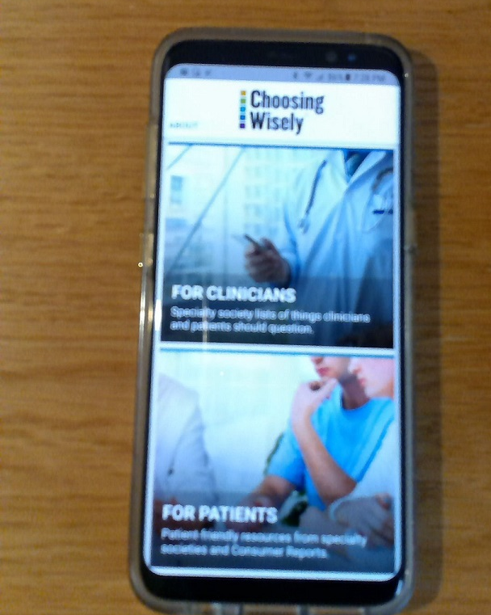
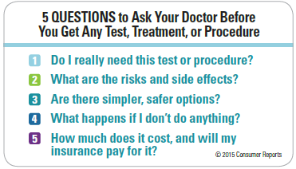
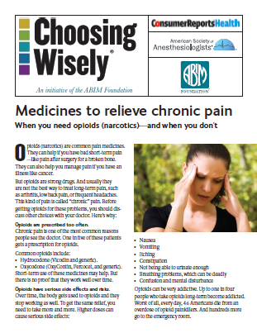
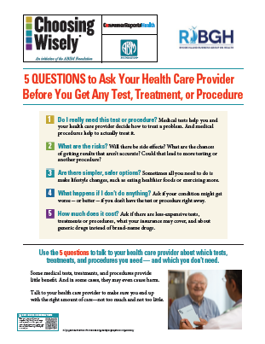

Patient Materials & Tools
Provided Free of Charge:
110+ Patient-Friendly, Evidence-Based Materials accessible online
  Available in English and Spanish
5 Questions Posters & Wallet Cards
Choosing Wisely Cell Phone App
  Free and available on Google Play & iTunes
Patient Brochures
  Available in English and Spanish

Slide 11

Results
Consumer Reports Survey to Test Impact of CW 5 Questions (4519 Respondents)
  Tested Impact of CW 5 Questions
  20% changed their opinion of what to do
  22% changed their treatment plans
  90% would encourage others to ask 5 questions
Parkland Memorial Hospital, Dallas, TX
  Saved $750,000 Annually By Decreasing Unnecessary Diagnostic Testing
South County Hospital Back Imaging Study (RIQI)
  Reduced Unnecessary Medical Imaging by 30%
Other Success Data Located at www.choosingwisely.org

Slide 12
Suggested Areas of Focus
Antibiotics
Opioid-Based Pain Medications
Medical Imaging (CAT Scans, MRI’s, Ultrasounds)
Routine EKGs and Stress Tests
Vitamin D Tests

Slide 13
Launch Steps
Send Announcement Letters to Employees
Introduce the 5 Questions to Ask Your Doctor
Promote the CW Cellphone App & Materials
Choose Themes and Match CW Materials
  Heart Month
  Flu Season
Track any Impact

Slide 14
Creative Engagement Ideas
Choosing Wisely Scavenger Hunt
Word Searches
Choosing Wisely Trivia Quizzes
Monthly Newsletter Articles on a Choosing Wisely Topic

Slide 15
Location of Patient Tools
Patient Resource Materials
http://www.choosingwisely.org/patient-resources/ or https://www.facebook.com/choosingwiselyri
Posters and Wallet Cards
http://www.choosingwisely.org/getting-started/resource-library/additional-materials-for-patients/
Patient Brochures
https://www.ribgh.org/choosing-wisely-ri
Patient Videos
Dr. Bledsoe https://youtu.be/IzNaNSImYT4
Dr Brennan https://youtu.be/mY5JI-ivOEQ
Dr. Rodriguez https://www.youtube.com/watch?v=uDw7dQ93wcI

Slide 16
RIBGH Choosing Wisely Contact
Choosing Wisely:
Joanne Bilotta, Campaign Manager & Board Member, Choosing Wisely Campaign
  jbilotta.RIBGH@gmail.com or (508) 404-6560

