Slide 1
RI Primary Care Provider Workforce: meeting the needs of today and tomorrow
Rhode Island Business Group on Health
Jeffrey Borkan, MD, PhD
Assistant Dean for Primary Care-Population Medicine – Brown University
Co-Leader Primary Care Provider Workforce

Slide 2


CURRENT STATE
Is the crisis coming or is it already here?
  Who has a primary care doctor?
  Who has had trouble getting an appointment?
There will not be enough primary care physicians in RI to serve the population and PAs and NPs will not be in sufficient numbers to fill the gap

Slide 3

Primary Care Burning Platform
Waning Access to Primary Care in RI with a ever growing deficit – while RI population expands – increased by 35,576 since 2019
Rampant Burnout/ Moral Injury
  Pandemic exacerbated situation; some practices did not survive
  Electronic health record/administrative task growth
  Cutting back, early retirements, job changes
  Out of control student debt
Health Systems Crush/Collapse
  Fragility and closure of healthcare systems (MHRI, Compass Medical, 2023)
  Competition from for-profits/venture capital
  Salary disparities –locally, regionally, and nationally
Prepared by Care Transformation Collaborative of RI
Notes:
Moral injury is the damage done to one’s conscience or moral compass when that person perpetrates, witnesses, or fails to prevent acts that transgress one’s own moral beliefs, values, or ethical codes of conduct.
Shortage of 100 PCP in Rhode Island (https://www.graham-center.org/content/dam/rgc/documents/maps-data-tools/state-collections/workforce-projections/Rhode%20Island.pdf)
https://www.fiercehealthcare.com/providers/massachusetts-providers-unexpected-closure-prompts-class-action-alleging-negligence

Slide 4
Updated Definition of Primary Care
High-quality primary care is the provision of whole-person, integrated, accessible, and equitable health care by interprofessional teams that are accountable for addressing the majority of an individual’s health and wellness needs across settings and through sustained relationships with patients, families, and communities.
Notes:
This definition reflects key societal and sector shifts from 1996 to now:
shift from provision of services to integrated, whole-person health
foundational, sustained relationships at the core
importance of communities and their roles in the provision of high-quality primary care
need for primary care to be equitable
interprofessional care teams that deliver primary care
diversity of settings and modalities used to deliver primary care

Slide 5
Rhode Island Physician Workforce Profile (AAMC 2019)
Family Medicine/General Practice: 305
Internal Medicine/Pediatrics: 20
Internal Medicine: 615
Pediatrics: 260
1200 total
Active Patient Care Primary Care Physicians per 100,000 Population 2018: 106.6 (rank 4th by state)
Notes:
Want to be clear – OB/GYNs and Psychiatrists are not delivering primary care – though both disciplines considered it in the 1990s

Slide 6
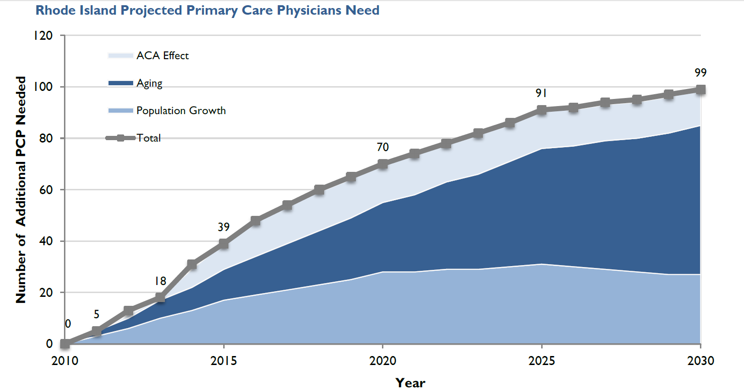
Rhode Island Project Primary Care Physicians Need*
*Petterson, Stephen M; Cai, Angela; Moore, Miranda; Bazemore, Andrew. State-level projections of primary care workforce, 2010-2030. September 2013, Robert Graham Center, Washington, D.C.
Notes:
More primary care doctors are retiring then coming in – and NPs, Pas are both subspecializing and need more training after graduation

Slide 7
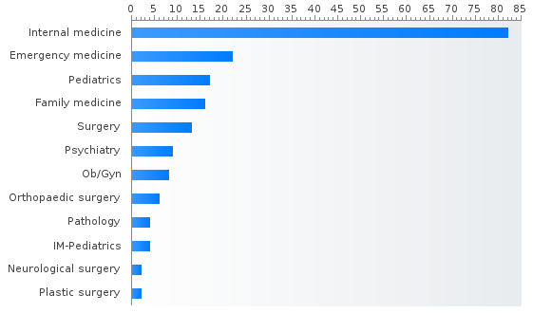
Number of Positions by Specialty in Rhode Island:
PGY-1 main residency Match data for 2020 (total 185)*
PGY-1 & 2 Match Data for 2020 (total 221)**
Internal medicine (82)
Emergency medicine (22)
Pediatrics (17)
Family medicine (16)
Surgery (13)
Psychiatry (9)
Obstetrics and gynecology (8)
Orthopaedic surgery (6)
Pathology-anatomic and clinical (4)
Internal Medicine-Pediatrics (4)
Neurological surgery (2)
Plastic surgery (2)
45% “Primary Care” Good??
*https://www.residencyprogramslist.com/in-rhode-island
** https”//www.nrmp.org

Slide 8
Primary Care GME Training in RI
35 Practicing Primary Care GME grads from a total of approximately 220 residency grads per year in RI = 16%
16%....maybe not so good??
Notes:
41 in primary care in 2022 with 18 staying in RI

Slide 9

Is the cavalry coming?

Slide 10


Physician Assistants in Rhode Island
549 certified PAs
  300 in 2014 (Largest % increase nationally)
50.1 PAs/100k – Ranked 22nd
  National 47.6 PAs/100k
New England
  MA – 4317
  CT – 2847
  ME – 986
  NH – 991
  VT - 423
*Data courtesy of NCCPA Statistical Profile of Certified PAs
Notes:
Largest increase 2016-2020
Team model

Slide 11

PAs in Primary Care in RI
Primary Care (FM/GP, General IM, Pedi)
16.5% in Rhode Island (91)
  Slight increase from 2020
23.7% Nationally
  Down from 26.7% in 2017
Distribution by most frequently practiced specialty:
  19.6% Surgical Subspecialties
  17 % Emergency Medicine
  9.4 % Internal Medicine Subspecialties
*Data courtesy of NCCPA Statistical Profile of Certified PAs
Notes:
Cardiology # 1 internal medicine subspecialty

Slide 12
NURSE PRACTITIONER SPECIATIES IN RI
1333 Nurse Practitioners in RI*
70% (933) WORKING IN PRIMARY CARE SETTINGS (FQHC’s, CHC’s, Hospital based clinics, Private practice)
4% IN ACUTE CARE SETTINGS (Urgent, In-patient: critical and acute care, ED)
13% Long Term Care
10% Psychiatric mental health nurse practitioner
2% Neonatal
NP’S MORE LIKELY TO WORK IN HEALTH CENTERS, OUT-PT CLINICS, HOSPITAL BASED CLINICS.
FOCUS ON TEAM BASED PHC TO ENHANCE AND INCREASE PATIENT ACCESS.
PETERSON, ET AL (2013)
Notes:
PERCENTAGES ARE APPROXIMATE, BASED ON COMPARISONS TO NATIONAL PERCENTAGES AND THE FACT THAT ACNP’S ARE NOT LICENSED SEPARATELY
KFF https://www.kff.org/other/state-indicator/total-number-of-nurse-practitioners/?currentTimeframe=0&sortModel=%7B%22colId%22:%22Location%22,%22sort%22:%22asc%22%7D

Slide 13

NP EDUCATION IN RI
Filling the Primary Care Need?
Nurse Practitioner PROGRAMS IN RI (PRIMARY CARE)
URI: 20-30 grads/year
SALVE: 7-10 grads/year
WON’T MEET PRIMARY HEALTH CARE NEEDS
Notes:
SAlVE; Since online, many move out of state. 80% of URI grads stay in state. 65% of URI grads go into PHC
RIC: Acute care only. Not certified or licenced in primary health care.

Slide 14
RI Primary Care Training Program 2023 Data

Slide 15
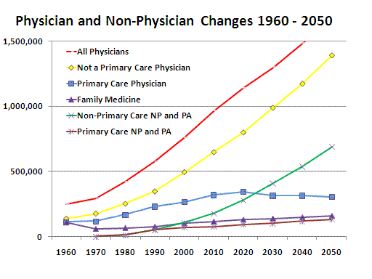
The workforce future looks bleak unless we act!

Slide 16
Why does this matter?

Slide 17

Advantages of Robust Primary Care
Combines prevention, acute care, and chronic care
Whole person approach and management
Improved health outcomes
Improved longevity
Saves money
Notes:
Like Bud Light: Tastes Great, Less Filling

Slide 18
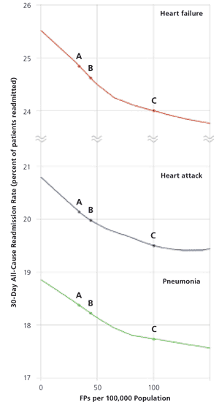
Associated Value
Adding one FP per 1,000 population, or 100 per 100,000 reduces readmission odds for:
  Pneumonia 7%
  Heart Attack 5%
  Congestive Heart Failure 8%
46 FPs per 100,000 population = -$81 million per year
100 FPs/100,000 population = -$579 million per year
Chetty, Culpepper, et al. Amer Fam Phys. May, 2011 1;83(9);1054

Slide 19

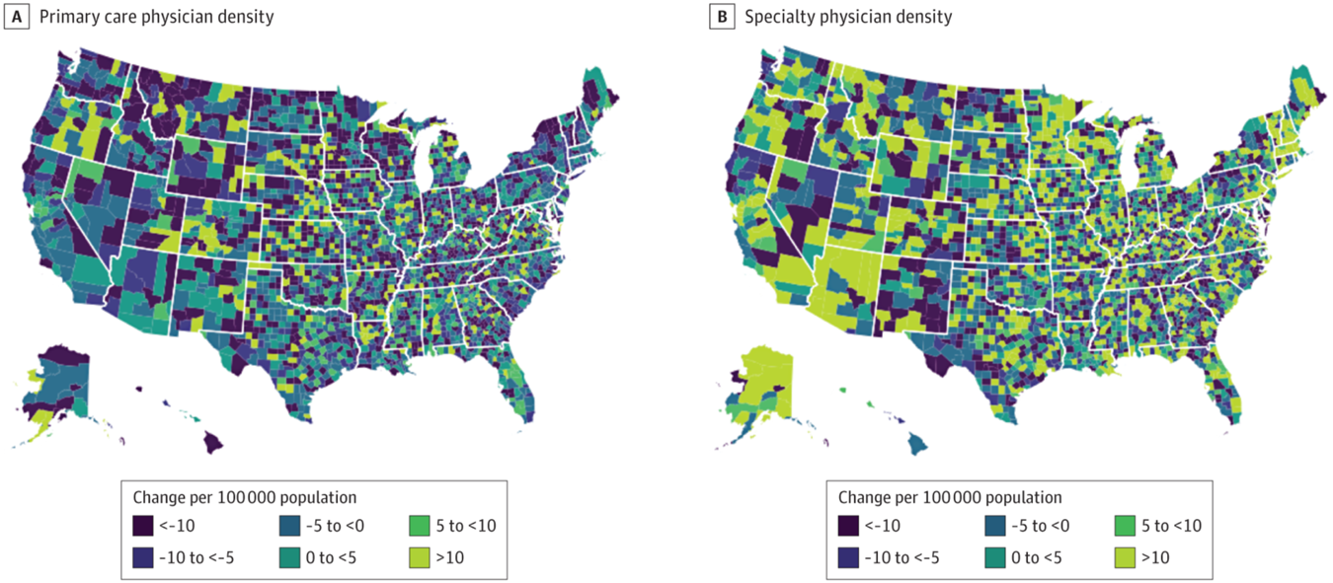
Association of Primary Care Physician Supply With Population Mortality in the United States, 2005-2015
Every 10 additional primary care physicians per 100 000 population was associated with a 51.5-day increase in life expectancy.
.
However, density of primary care physicians decreased while the density of specialists increased
JAMA Intern Med. Published online February 18, 2019
Notes:
However, from 2005 to 2015, the density of primary care physicians decreased from 46.6 to 41.4 per 100 000 population. Concurrently, the number of specialist physicians increased from 699 989 in 2005 to 805 277 in 2015, corresponding to 68.0 per 100 000 population in 2005 to 71.3 per 100 000 population in 2015

Slide 20
US 2005-32%
US entering residency classes 2014 22.3%*
Notes:
Deutchman M, Macaluso F, Chao J, et al. Contributions of US Medical Schools to Primary Care (2003-2014): Determining and Predicting Who Really Goes Into Primary Care. Fam Med. 2020;52(7):483-490. https://doi.org/10.22454/FamMed.2020.785068.

Slide 21

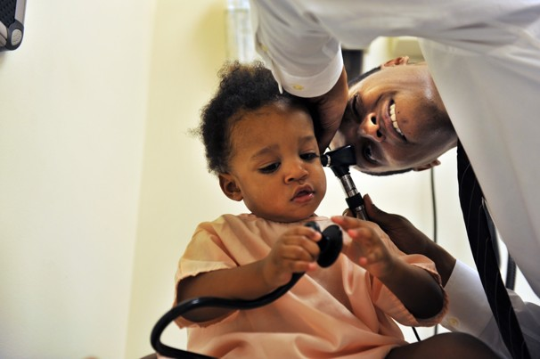
Success of health reform hinges on hiring 30,000 primary care doctors by 2015
Didn’t happen, see 2018 AAMC Report on Workforce 2016-2030 – huge gap

Slide 22
Merritt Hawkins
Primacy of primary care: For the 13th straight year, family physicians led the list of the 20 most requested recruiting assignments. Demand for primary care physicians is driven by common factors across multiple specialties such as the country's aging population, but new care models that emphasize prevention, quality payments, and care coordination also are pivotal drivers, the report says.

Slide 23


What are we going to do?

Slide 24
Primary Care Provider Taskforce
Overarching Goal: Rhode Island to be #1 in population health and health equity
Convenes leadership from Rhode Island training programs for physicians, nurse practitioners, and physician assistants.
Chief Objective: Build a strong and robust primary care delivery system across the state that attracts, trains, supports, sustains and retains primary care providers and provides exceptional, accessible, patient-centered care to the people of Rhode Island
6/14/2023 Prepared by Care Transformation Collaborative of RI
Notes:
To accomplish this and to improve population health and health equity, we need a data-driven approach to increase access so all Rhode Islanders have a primary care Patient Centered care team, led by a primary care provider who delivers high quality, coordinated, integrated and affordable primary care.

Slide 25
Primary Care Provider Taskforce: Charter
Goals:
Collaborate between training program leadership and state programs focused on healthcare workforce, and primary care experts
Establish best practices for encouraging more primary care engagement, including incentives for trainees and trainers, and new models of interdisciplinary and team-based care training
Build team based primary care that increases patient access (and prevents more expensive emergency department and hospital admissions)
Deliverable: A statewide strategic plan for recruiting, training, retaining and sustaining a primary care provider workforce sufficient to meet Rhode Islands population health needs.
6/14/2023 Prepared by Care Transformation Collaborative of RI
Notes:
Highlight changes made in yellow

Slide 26
Invitees
Michelle Anvar, MD, Division of Primary Care, Brown Medicine Rick Brooks, Director of Healthcare Workforce Transformation, EOHHS Fadya El Rayess, MD, MPH, Residency Director, Brown Family Medicine Julia Harvey, Health Care Advocate, Office of the Attorney General Matthew R Harvey, Interim Executive Director, Integra Community Care Peter Hollmann, MD, Chief Medical Officer at Brown University Medicine Ashley Hughes, MSPAS, PA-C, Program Director, Physician Assistant Program at Bryant University Mark Jacobs, MD, Internal Medicine Cory King, Health Insurance Commissioner Robin Kremsdorf, MD, Interim Program Director at Hasbro Children’s Hospital Elizabeth Lange, MD FAAP, Co-Director PCMH-Kids, Pediatrician, Waterman Pediatrics/Coastal Medical Lifespan Pam Lauria, NP, State Senator at RI State Legislature Brian Lurie, MD,MPH, Pediatric Residency Program Director, Hasbro Children's Hospital | Kelly McGarry, MD, Program Director, General Internal Medicine/Primary Care T Brown Medicine Suzanne E McLaughlin, MD, Director, Medicine Pediatrics at Lifespan Thomas Meehan, Ph.D., PA-C, Program Director, Physician Assistant Program at Johnson and Wales University John Miskovsky, MD, Program Director, Internal Medicine at Roger Williams University Elena Nicolella, CEO/President, Rhode Island Health Care Association Peter Hollmann MD, Chief Medical Officer at Brown University Medicine Matthew Roman, COO, Thundermist Health Center Rachel Simmons, MD, Residency Director, Brown Internal Medicine Sharon L Stager, DNP, APRN, FNP-BC, Director, Family NP Program at Salve Regina University Mariah Stump, MD, MPH, FACP, Co-Chair of Primary Care Physician's Advisory Committee (PCPAC) for RIDOH
6/14/2023 Prepared by Care Transformation Collaborative of RI
Notes:
AG Meeting, Julia Harvey on attendance list

Slide 27
Task Force Co-Chairs
  Jeffrey Borkan, MD, PhD – Assistant Dean for Primary Care – Population Medicine at the Warren Alpert Medical School of Brown University – Task Force Co-Chair
  Denise Coppa, PhD, CNP, FAAN, FAANP, Program Director, Family NP Program at University of Rhode Island
Project Team:
  Debra Hurwitz, MBA, BSN, RN – Executive Director – Care Transformation Collaborative Rhode Island
  Pat Flanagan, MD – Clinical Director and PCMH Kids Co-Chair – Care Transformation Collaborative Rhode Island
  Yolanda Bowes, Program Manager – Care Transformation Collaborative Rhode Island
6/14/2023 Prepared by Care Transformation Collaborative of RI

Slide 28
Strategic Goals Identified
Goal #1 | Reform and increase payments, incentives, and salaries to primary care providers to create parity with other specialties and regionally
Goal #2 | Increase the recruitment of medical students, medical residents and NP and PA trainees entering primary care - Reduce Tuition and Student Debt for those providers going into Primary Care in RI
Goal #3 | Increase the funding for training Primary Care Providers and the number of high-quality Primary Care training sites
Goal #4 | Enhance onsite clinical training in advanced patient-centered medical home (PCMH) principles such as team-based care, integrated behavioral health, practice transformation, and payment reform for training sites
Goal #5 | Expand Primary Care Provider Workforce Diversity, Equity, and Inclusion
Goal #6 | Identify data sources on primary care providers to establish a baseline and provide ongoing monitoring of the effectiveness of the plan

Slide 29
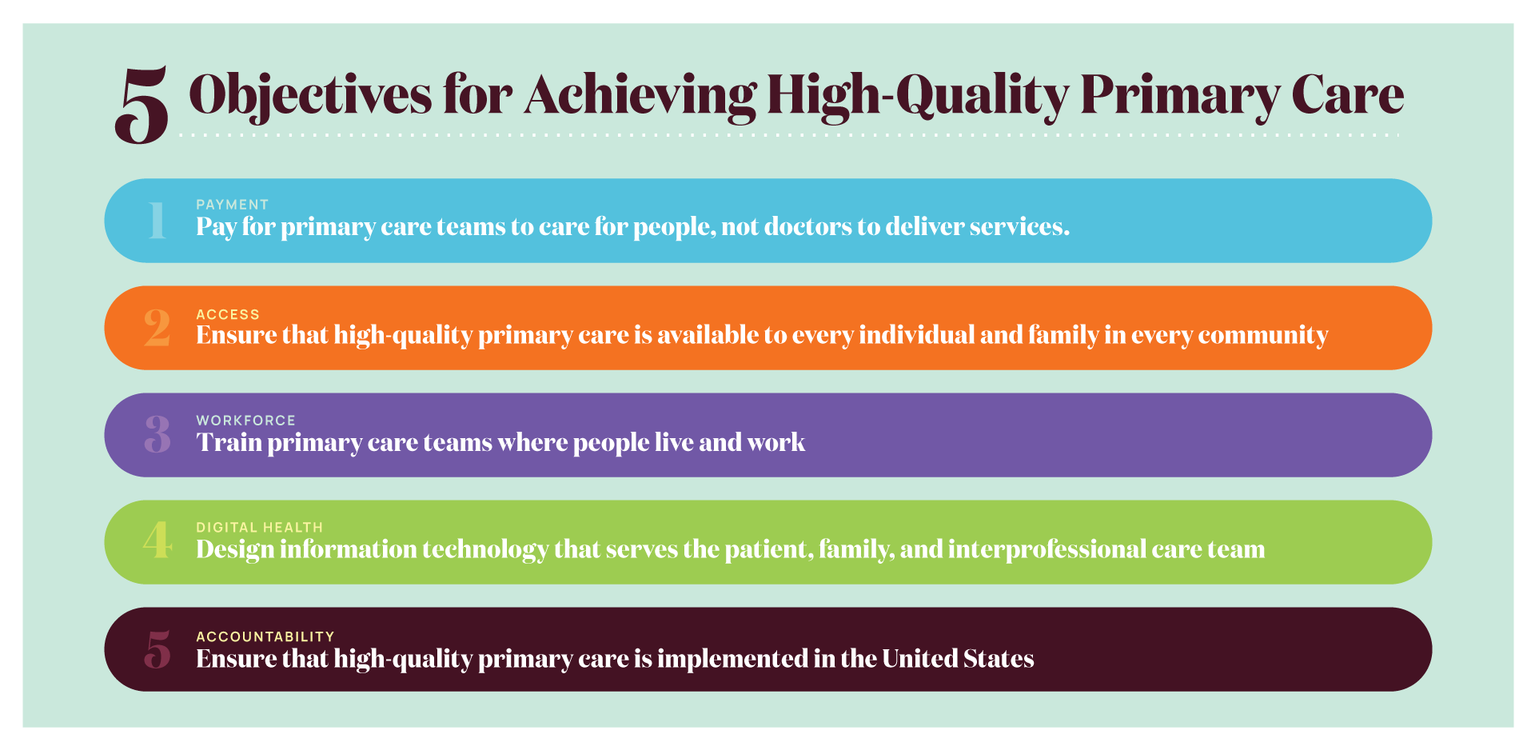
Notes:
The committee’s recommended actions that make up its implementation plan seek to achieve 5 major objectives to achieve high-quality primary care.
Pay for primary care teams to care for people, not doctors to deliver services.
The nation gets what it pays for, and payment reform that supports and encourages high-quality primary care, rather than actively discouraging it, is fundamental to the committee’s vision of high-quality primary care.
Ensure that high-quality primary care is available to every individual and family in every community.
Everyone in the country should have easy access to high-quality primary care that is person-centered, relationship-oriented, and responsive to the needs of its community.
Train primary care teams where people live and work.
When primary care training is interprofessional and located in community settings, it is more effective at developing the skills that will keep people connected and healthy.
Design information technology that serves the patient, family, and interprofessional care team.
New health information technology standards should prioritize and facilitate integrated care that is person-centered, supports relationships, and is responsive to the needs of its community.
Ensure that high-quality primary care is implemented in the United States.
Implementing high-quality primary care requires clear and meaningful measures of whole-person care, ongoing research, and leadership in the federal government to assure federal policies support its development.

Slide 30
What do you need from primary care?
Cost effective, high quality, accessible and equitable primary for care for employees (and their families) so that employees are happy, healthy and on the job
The right care at the right place at the right time – with coordination

Slide 31
What we want to do:
Focus on the work we can do as educators, trainers, and academics – while coordinating with those working on other elements of the conundrum
6 key goal areas identified
Collect actionable data
Determine the target audience
Drill down into objectives and action items for each goal
Task Force plans to release the primary care workforce strategic plan by the end of the year.
6/14/2023 Prepared by Care Transformation Collaborative of RI

Slide 32
What you might do:
Demand that your health insurance plans assign every member to a primary care provider – “primary care for all”
Pressure payers for payment reform -- increased payment through value-based contracts and capitation
Recruit, support, and retain primary care providers though scholarships, loan repayment, paid preceptors for field training, innovative commitment programs, and other means
Ensure data collection and yearly reporting on the state of primary care workforce.
Advocate with the Governor’s office and legislative leaders for State appropriation in primary care, (including the above)
Push for primary care as public good

Slide 33
Primary Care as a Common Good
High quality primary care has high societal value among health care services
Requires public policy for oversight and monitoring
Needs strong advocacy, organized leadership, and public awareness
Notes:
A common good is:
rivalrous (limited, so more for one person means less for another)
non-excludable (users cannot be prevented from accessing it, regardless of whether they have paid)
The committee strongly believes that because of its societal value and that it is designed for everyone to use throughout their lives, primary care deserves to be treated as a common good. The committee believes its implementation plan will elevate primary care to the common good status it deserves and that the country needs.
Patient choice is important but we are not going to compete our way to a stronger role for primary care in our delivery system any more than we compete our way to a stronger elementary and secondary education system

Slide 34

6/14/2023 Prepared by Care Transformation Collaborative of RI

